Slide 1

MODULE 3: DATA STORAGE AND QUERY PROCESSING
Record storage and Primary file organization- Secondary storage Devices- Operations on Files- Heap File- Sorted Files- Hashing Techniques – Index Structure for files –Different types of Indexes- B-Tree - B+Tree – Query Processing.

Slide 2
Agenda
Overview of Physical Storage Media
Magnetic Disks
Storage Access
File Organization
Organization of Records in Files
Data-Dictionary Storage

Slide 3
Classification of Physical Storage Media
Speed with which data can be accessed
Cost per unit of data
Reliability
data loss on power failure or system crash
physical failure of the storage device
Can differentiate storage into:
volatile storage: loses contents when power is switched off
non-volatile storage:
Contents persist even when power is switched off.
Includes secondary and tertiary storage, as well as batter-backed up main-memory.

Slide 4
Physical Storage Media
Cache – fastest and most costly form of storage; volatile; managed by the computer system hardware.
Main memory:
fast access (10s to 100s of nanoseconds; 1 nanosecond = 10^{–9} seconds)
generally too small (or too expensive) to store the entire database
capacities of up to a few Gigabytes widely used currently
Capacities have gone up and per-byte costs have decreased steadily and rapidly (roughly factor of 2 every 2 to 3 years)
Volatile — contents of main memory are usually lost if a power failure or system crash occurs.

Slide 5
Physical Storage Media (Cont.)
Flash memory
Data survives power failure
Data can be written at a location only once, but location can be erased and written to again
Can support only a limited number of write/erase cycles.
Erasing of memory has to be done to an entire bank of memory
Reads are roughly as fast as main memory
But writes are slow (few microseconds), erase is slower
Cost per unit of storage roughly similar to main memory
Widely used in embedded devices such as digital cameras
also known as EEPROM (Electrically Erasable Programmable Read-Only Memory)

Slide 6
Physical Storage Media (Cont.)
Magnetic-disk
Data is stored on spinning disk, and read/written magnetically
Primary medium for the long-term storage of data; typically stores entire database.
Data must be moved from disk to main memory for access, and written back for storage
Much slower access than main memory.
direct-access – possible to read data on disk in any order, unlike magnetic tape
Hard disks vs floppy disks
Capacities range up to roughly 100 GB currently
Much larger capacity and cost/byte than main memory/flash memory
Growing constantly and rapidly with technology improvements (factor of 2 to 3 every 2 years)
Survives power failures and system crashes
disk failure can destroy data, but is very rare

Slide 7
Physical Storage Media (Cont.)
Optical storage
non-volatile, data is read optically from a spinning disk using a laser
CD-ROM (640 MB) and DVD (4.7 to 17 GB) most popular forms
Write-one, read-many (WORM) optical disks used for archival storage (CD-R and DVD-R)
Multiple write versions also available (CD-RW, DVD-RW, and DVD-RAM)
Reads and writes are slower than with magnetic disk
Juke-box systems, with large numbers of removable disks, a few drives, and a mechanism for automatic loading/unloading of disks available for storing large volumes of data

Slide 8
Physical Storage Media (Cont.)
Tape storage
non-volatile, used primarily for backup (to recover from disk failure), and for archival data
sequential-access – much slower than disk
very high capacity (40 to 300 GB tapes available)
tape can be removed from drive ⇒ storage costs much cheaper than disk, but drives are expensive
Tape jukeboxes available for storing massive amounts of data
hundreds of terabytes (1 terabyte = 10⁹ bytes) to even a petabyte (1 petabyte = 10¹² bytes)

Slide 9
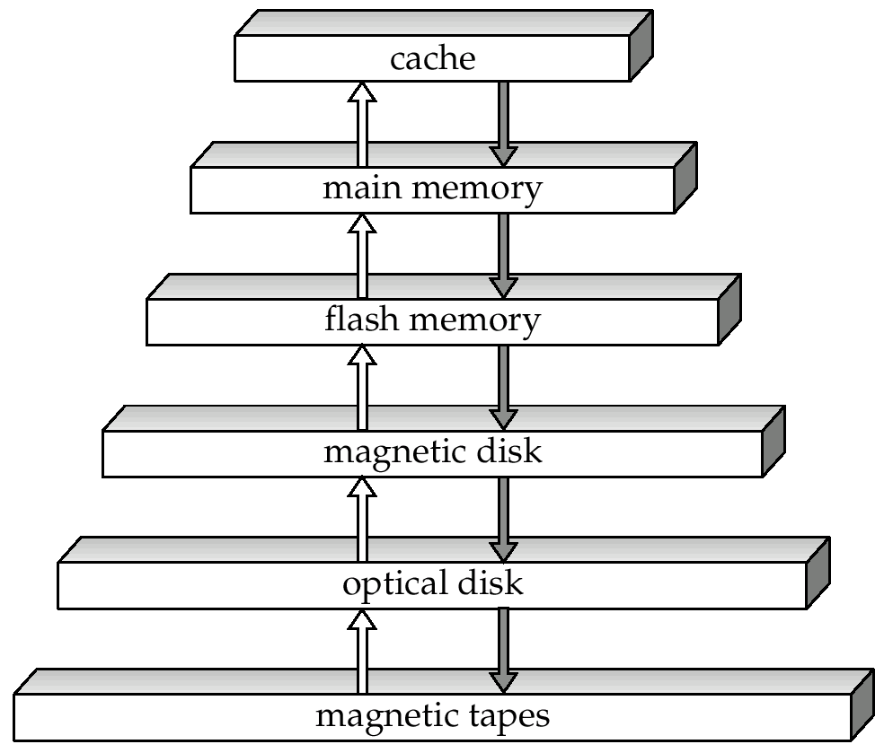
Storage Hierarchy

Slide 10
Storage Hierarchy (Cont.)
primary storage: Fastest media but volatile (cache, main memory).
secondary storage: next level in hierarchy, non-volatile, moderately fast access time
also called on-line storage
E.g. flash memory, magnetic disks
tertiary storage: lowest level in hierarchy, non-volatile, slow access time
also called off-line storage
E.g. magnetic tape, optical storage

Slide 11
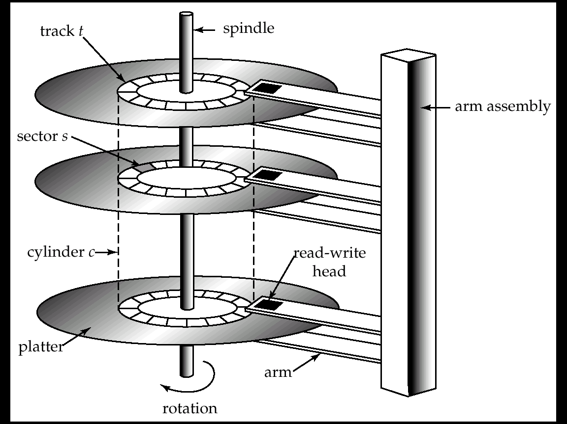
Magnetic Hard Disk Mechanism
NOTE: Diagram is schematic, and simplifies the structure of actual disk drives

Slide 12
Magnetic Disks
Read-write head
Positioned very close to the platter surface (almost touching it)
Reads or writes magnetically encoded information.
Surface of platter divided into circular tracks
Over 16,000 tracks per platter on typical hard disks
Each track is divided into sectors.
A sector is the smallest unit of data that can be read or written.
Sector size typically 512 bytes
Typical sectors per track: 200 (on inner tracks) to 400 (on outer tracks)
To read/write a sector
disk arm swings to position head on right track
platter spins continually; data is read/written as sector passes under head
Head-disk assemblies
multiple disk platters on a single spindle (typically 2 to 4)
one head per platter, mounted on a common arm.
Cylinder i consists of i^{th} track of all the platters

Slide 13
Magnetic Disks (Cont.)
Earlier generation disks were susceptible to head-crashes
Surface of earlier generation disks had metal-oxide coatings which would disintegrate on head crash and damage all data on disk
Current generation disks are less susceptible to such disastrous failures, although individual sectors may get corrupted
Disk controller – interfaces between the computer system and the disk drive hardware.
accepts high-level commands to read or write a sector
initiates actions such as moving the disk arm to the right track and actually reading or writing the data
Computes and attaches checksums to each sector to verify that data is read back correctly
If data is corrupted, with very high probability stored checksum won’t match recomputed checksum
Ensures successful writing by reading back sector after writing it
Performs remapping of bad sectors

Slide 14
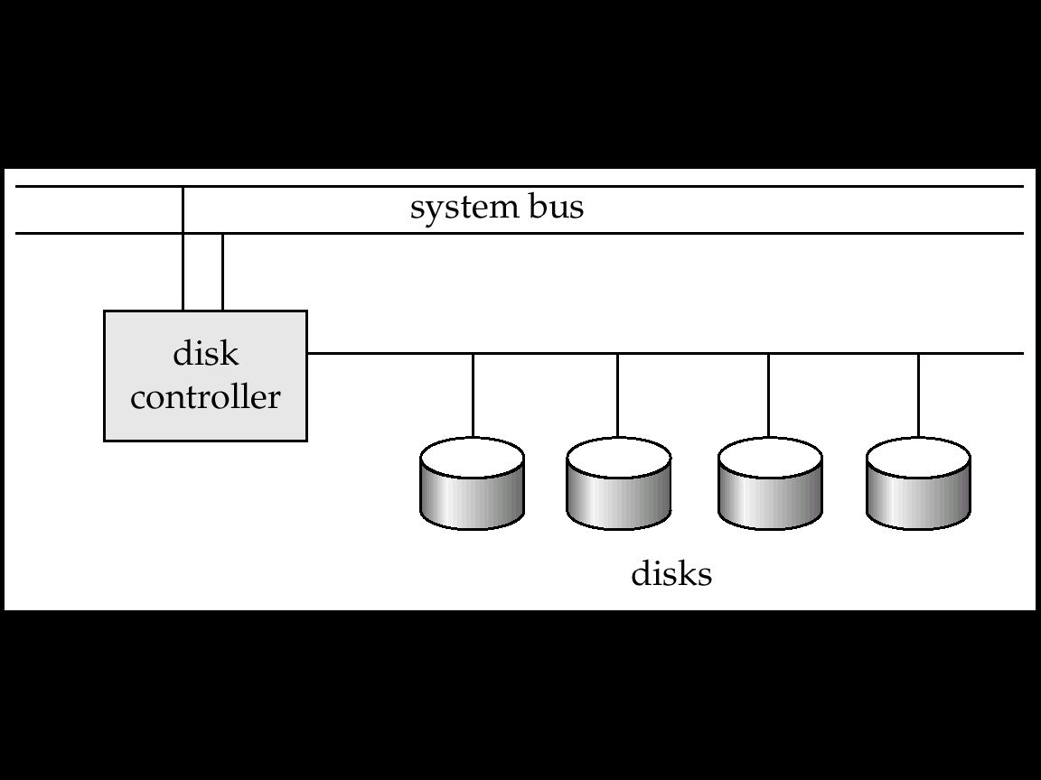
Disk Subsystem
Multiple disks connected to a computer system through a controller
Controllers functionality (checksum, bad sector remapping) often carried out by individual disks; reduces load on controller
Disk interface standards families
ATA (AT adaptor) range of standards
SCSI (Small Computer System Interconnect) range of standards
Several variants of each standard (different speeds and capabilities)

Slide 15
Performance Measures of Disks
Access time – the time it takes from when a read or write request is issued to when data transfer begins. Consists of:
Seek time – time it takes to reposition the arm over the correct track.
Average seek time is 1/2 the worst case seek time.
Would be 1/3 if all tracks had the same number of sectors, and we ignore the time to start and stop arm movement
4 to 10 milliseconds on typical disks
Rotational latency – time it takes for the sector to be accessed to appear under the head.
Average latency is 1/2 of the worst case latency.
4 to 11 milliseconds on typical disks (5400 to 15000 r.p.m.)
Data-transfer rate – the rate at which data can be retrieved from or stored to the disk.
4 to 8 MB per second is typical
Multiple disks may share a controller, so rate that controller can handle is also important
E.g. ATA-5: 66 MB/second, SCSI-3: 40 MB/s
Fiber Channel: 256 MB/s

Slide 16
Performance Measures (Cont.)
Mean time to failure (MTTF) – the average time the disk is expected to run continuously without any failure.
Typically 3 to 5 years
Probability of failure of new disks is quite low, corresponding to a “theoretical MTTF” of 30,000 to 1,200,000 hours for a new disk
E.g., an MTTF of 1,200,000 hours for a new disk means that given 1000 relatively new disks, on an average one will fail every 1200 hours
MTTF decreases as disk ages

Slide 17
Optimization of Disk-Block Access
Block – a contiguous sequence of sectors from a single track
data is transferred between disk and main memory in blocks
sizes range from 512 bytes to several kilobytes
Smaller blocks: more transfers from disk
Larger blocks: more space wasted due to partially filled blocks
Typical block sizes today range from 4 to 16 kilobytes
Disk-arm-scheduling algorithms order pending accesses to tracks so that disk arm movement is minimized
elevator algorithm : move disk arm in one direction (from outer to inner tracks or vice versa), processing next request in that direction, till no more requests in that direction, then reverse direction and repeat

Slide 18
Optimization of Disk Block Access (Cont.)
File organization – optimize block access time by organizing the blocks to correspond to how data will be accessed
E.g. Store related information on the same or nearby cylinders.
Files may get fragmented over time
E.g. if data is inserted to/deleted from the file
Or free blocks on disk are scattered, and newly created file has its blocks scattered over the disk
Sequential access to a fragmented file results in increased disk arm movement
Some systems have utilities to defragment the file system, in order to speed up file access

Slide 19
Optimization of Disk Block Access (Cont.)
Nonvolatile write buffers speed up disk writes by writing blocks to a non-volatile RAM buffer immediately
Non-volatile RAM: battery backed up RAM or flash memory
Even if power fails, the data is safe and will be written to disk when power returns
Controller then writes to disk whenever the disk has no other requests or request has been pending for some time
Database operations that require data to be safely stored before continuing can continue without waiting for data to be written to disk
Writes can be reordered to minimize disk arm movement
Log disk – a disk devoted to writing a sequential log of block updates
Used exactly like nonvolatile RAM
Write to log disk is very fast since no seeks are required
No need for special hardware (NV-RAM)
File systems typically reorder writes to disk to improve performance
Journaling file systems write data in safe order to NV-RAM or log disk
Reordering without journaling: risk of corruption of file system data

Slide 20
Optical Disks
Compact disk-read only memory (CD-ROM)
Disks can be loaded into or removed from a drive
High storage capacity (640 MB per disk)
High seek times or about 100 msec (optical read head is heavier and slower)
Higher latency (3000 RPM) and lower data-transfer rates (3-6 MB/s) compared to magnetic disks
Digital Video Disk (DVD)
DVD-5 holds 4.7 GB , and DVD-9 holds 8.5 GB
DVD-10 and DVD-18 are double sided formats with capacities of 9.4 GB and 17 GB
Other characteristics similar to CD-ROM
Record once versions (CD-R and DVD-R) are becoming popular
data can only be written once, and cannot be erased.
high capacity and long lifetime; used for archival storage
Multi-write versions (CD-RW, DVD-RW and DVD-RAM) also available

Slide 21
Magnetic Tapes
Hold large volumes of data and provide high transfer rates
Few GB for DAT (Digital Audio Tape) format, 10-40 GB with DLT (Digital Linear Tape) format, 100 GB+ with Ultrium format, and 330 GB with Ampex helical scan format
Transfer rates from few to 10s of MB/s
Currently the cheapest storage medium
Tapes are cheap, but cost of drives is very high
Very slow access time in comparison to magnetic disks and optical disks
limited to sequential access.
Some formats (Accelis) provide faster seek (10s of seconds) at cost of lower capacity
Used mainly for backup, for storage of infrequently used information, and as an off-line medium for transferring information from one system to another.
Tape jukeboxes used for very large capacity storage
(terabyte (10¹² bytes) to petabye (10¹⁵ bytes)

Slide 22
Storage Access
A database file is partitioned into fixed-length storage units called blocks. Blocks are units of both storage allocation and data transfer.
Database system seeks to minimize the number of block transfers between the disk and memory. We can reduce the number of disk accesses by keeping as many blocks as possible in main memory.
Buffer – portion of main memory available to store copies of disk blocks.
Buffer manager – subsystem responsible for allocating buffer space in main memory.

Slide 23
Buffer Manager
Programs call on the buffer manager when they need a block from disk.
If the block is already in the buffer, the requesting program is given the address of the block in main memory
If the block is not in the buffer,
the buffer manager allocates space in the buffer for the block, replacing (throwing out) some other block, if required, to make space for the new block.
The block that is thrown out is written back to disk only if it was modified since the most recent time that it was written to/fetched from the disk.
Once space is allocated in the buffer, the buffer manager reads the block from the disk to the buffer, and passes the address of the block in main memory to requester.

Slide 24
Buffer-Replacement Policies
Most operating systems replace the block least recently used (LRU strategy)
Idea behind LRU – use past pattern of block references as a predictor of future references
Queries have well-defined access patterns (such as sequential scans), and a database system can use the information in a user’s query to predict future references
LRU can be a bad strategy for certain access patterns involving repeated scans of data
e.g. when computing the join of 2 relations r and s by a nested loops for each tuple tr of r do for each tuple ts of s do if the tuples tr and ts match …
Mixed strategy with hints on replacement strategy provided by the query optimizer is preferable

Slide 25
Buffer-Replacement Policies (Cont.)
Pinned block – memory block that is not allowed to be written back to disk.
Toss-immediate strategy – frees the space occupied by a block as soon as the final tuple of that block has been processed
Most recently used (MRU) strategy – system must pin the block currently being processed. After the final tuple of that block has been processed, the block is unpinned, and it becomes the most recently used block.
Buffer manager can use statistical information regarding the probability that a request will reference a particular relation
E.g., the data dictionary is frequently accessed. Heuristic: keep data-dictionary blocks in main memory buffer
Buffer managers also support forced output of blocks for the purpose of recovery

Slide 26
File Organization
The database is stored as a collection of files. Each file is a sequence of records. A record is a sequence of fields.
One approach:
assume record size is fixed
each file has records of one particular type only
different files are used for different relations
This case is easiest to implement; will consider variable length records
later.

Slide 27
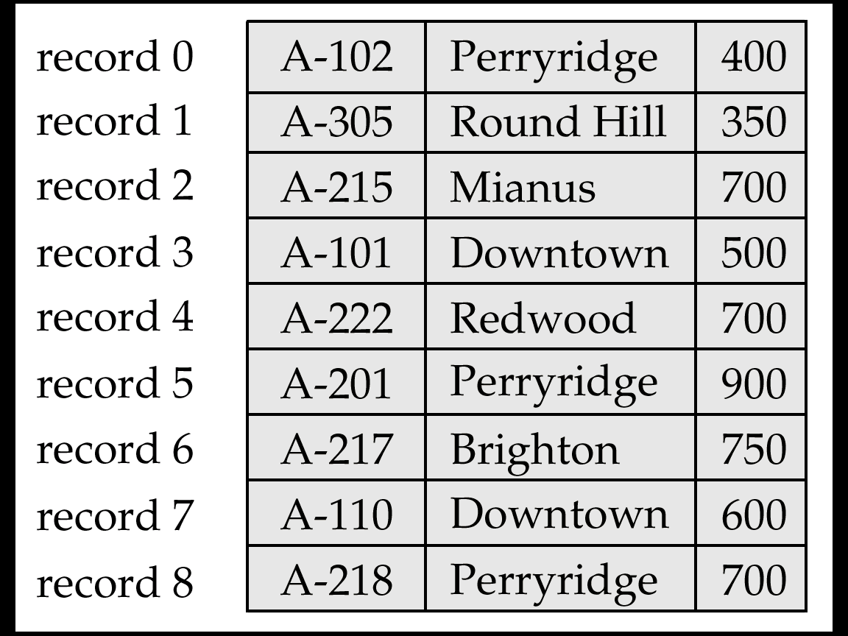
Fixed-Length Records
Simple approach:
Store record i starting from byte n ∗ (i – 1), where n is the size of each record.
Record access is simple but records may cross blocks
Modification: do not allow records to cross block boundaries
Deletion of record I: alternatives:
move records i + 1, . . ., n to i, . . . , n – 1
move record n to i
do not move records, but link all free records on a free list

Slide 28
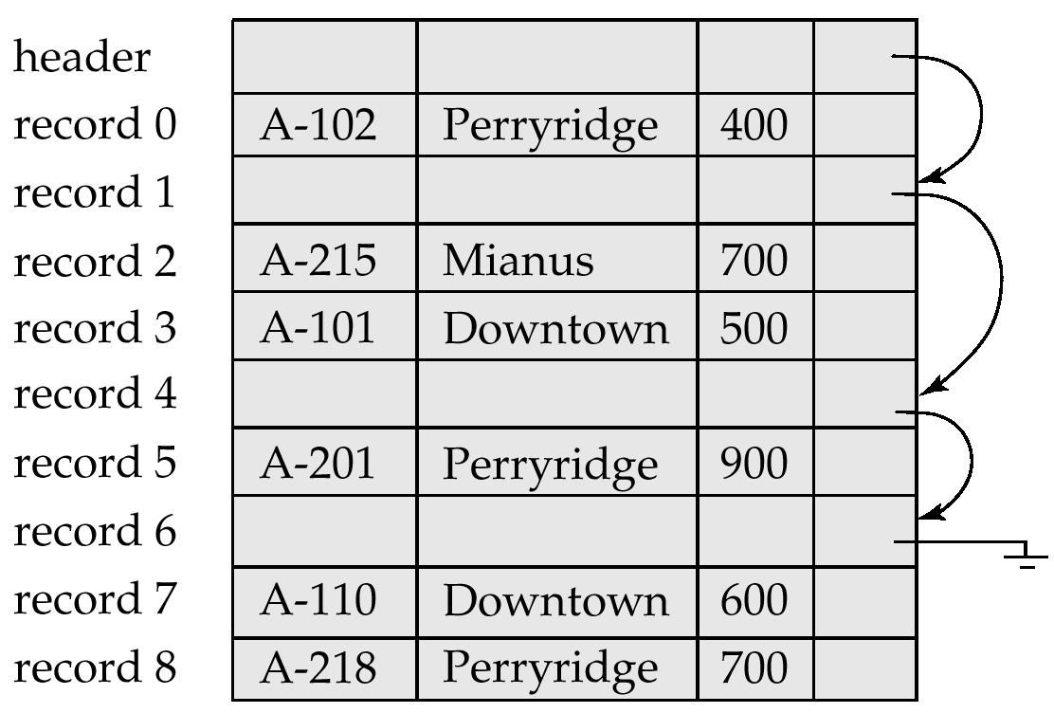
Free Lists
Store the address of the first deleted record in the file header.
Use this first record to store the address of the second deleted record, and so on
Can think of these stored addresses as pointers since they “point” to the location of a record.
More space efficient representation: reuse space for normal attributes of free records to store pointers. (No pointers stored in in-use records.)

Slide 29
Variable-Length Records
Variable-length records arise in database systems in several ways:
Storage of multiple record types in a file.
Record types that allow variable lengths for one or more fields.
Record types that allow repeating fields (used in some older data models).
Byte string representation
Attach an end-of-record (⊥) control character to the end of each record
Difficulty with deletion
Difficulty with growth

Slide 30
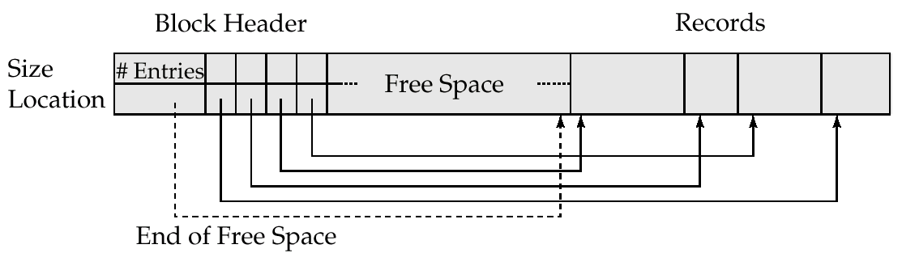
Variable-Length Records: Slotted Page Structure
Slotted page header contains:
number of record entries
end of free space in the block
location and size of each record
Records can be moved around within a page to keep them contiguous with no empty space between them; entry in the header must be updated.
Pointers should not point directly to record — instead they should point to the entry for the record in header.

Slide 31
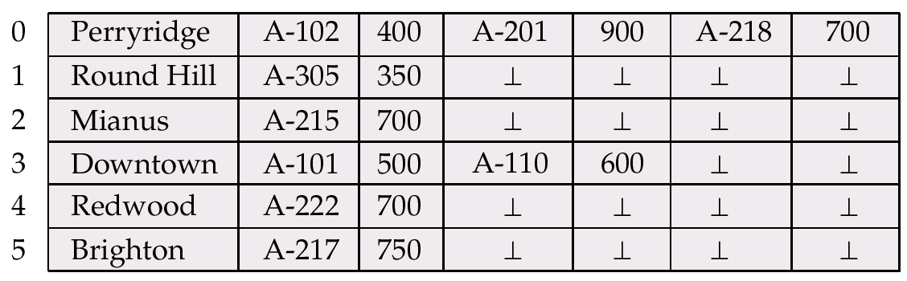
Variable-Length Records (Cont.)
Fixed-length representation:
reserved space
pointers
Reserved space – can use fixed-length records of a known maximum length; unused space in shorter records filled with a null or end-of-record symbol.

Slide 32
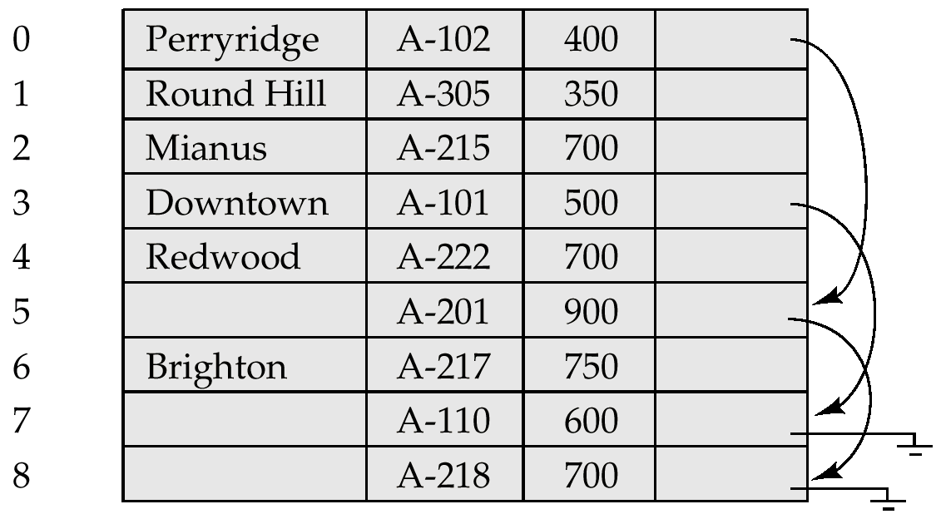
Pointer Method
Pointer method
A variable-length record is represented by a list of fixed-length records, chained together via pointers.
Can be used even if the maximum record length is not known

Slide 33
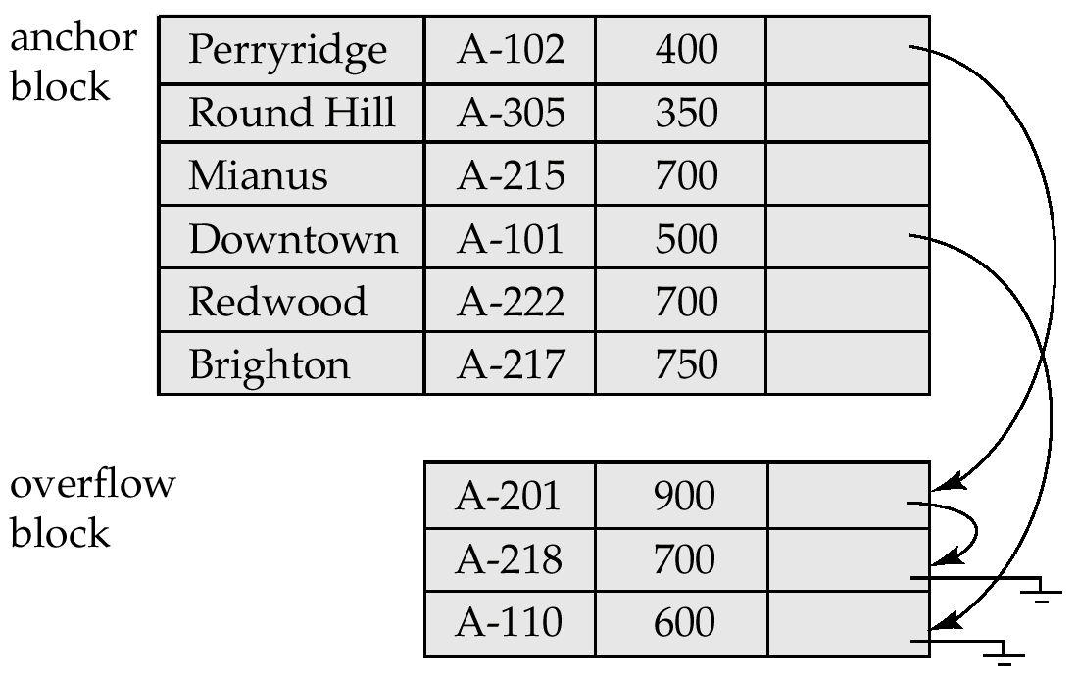
Pointer Method (Cont.)
Disadvantage to pointer structure; space is wasted in all records except the first in a a chain.
Solution is to allow two kinds of block in file:
Anchor block – contains the first records of chain
Overflow block – contains records other than those that are the first records of chairs.

Slide 34
Organization of Records in Files
Heap – a record can be placed anywhere in the file where there is space
Sequential – store records in sequential order, based on the value of the search key of each record
Hashing – a hash function computed on some attribute of each record; the result specifies in which block of the file the record should be placed
Records of each relation may be stored in a separate file. In a clustering file organization records of several different relations can be stored in the same file
Motivation: store related records on the same block to minimize I/O

Slide 35
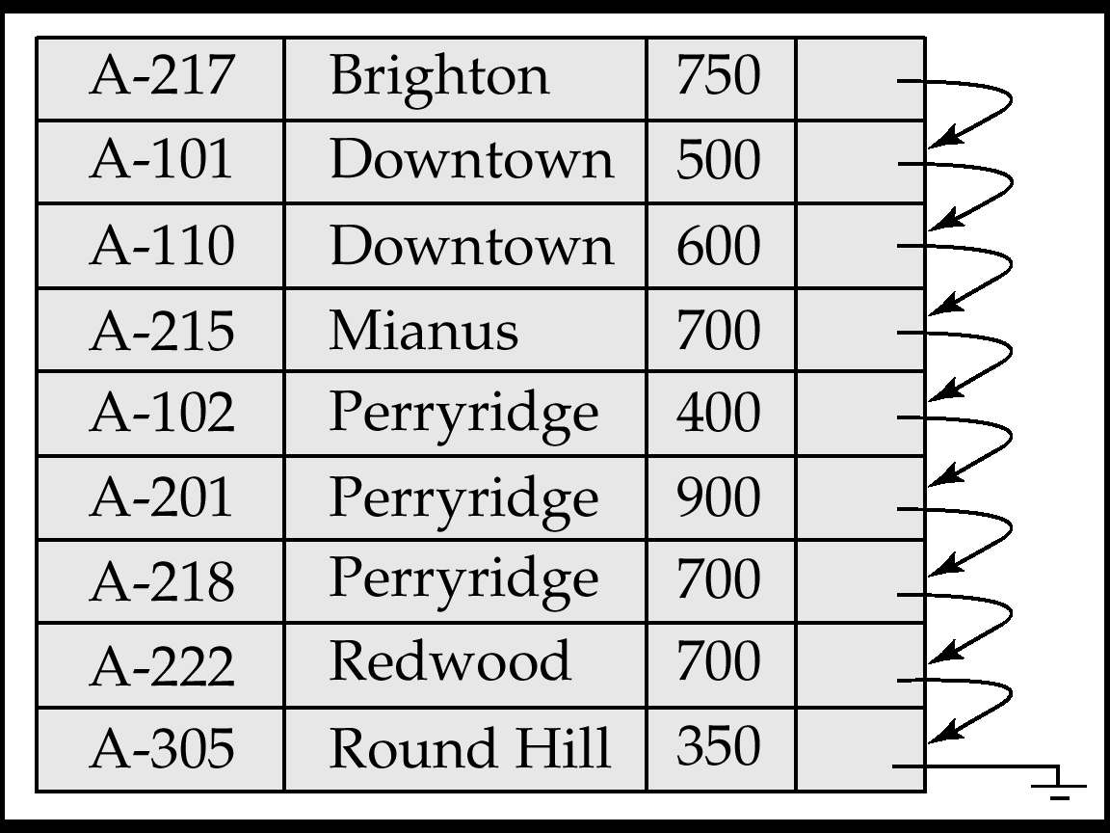
Sequential File Organization
Suitable for applications that require sequential processing of the entire file
The records in the file are ordered by a search-key

Slide 36
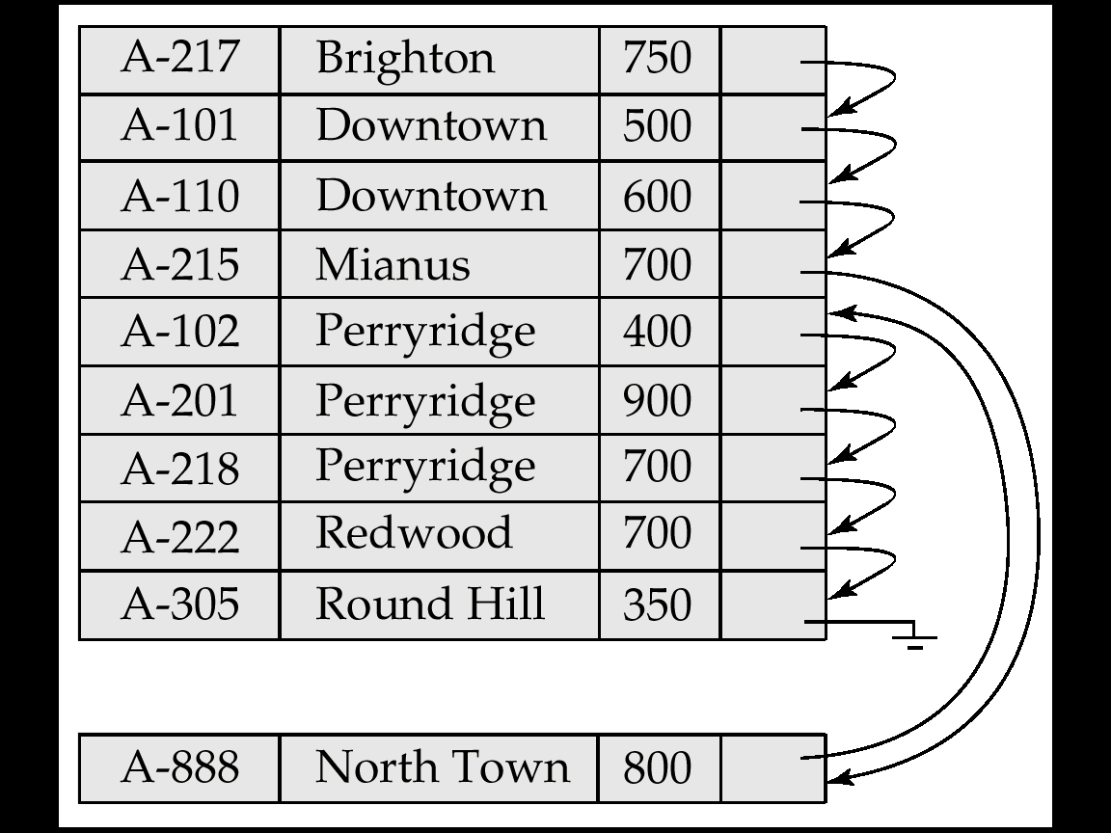
Sequential File Organization (Cont.)
Deletion – use pointer chains
Insertion –locate the position where the record is to be inserted
if there is free space insert there
if no free space, insert the record in an overflow block
In either case, pointer chain must be updated
Need to reorganize the file from time to time to restore sequential order

Slide 37
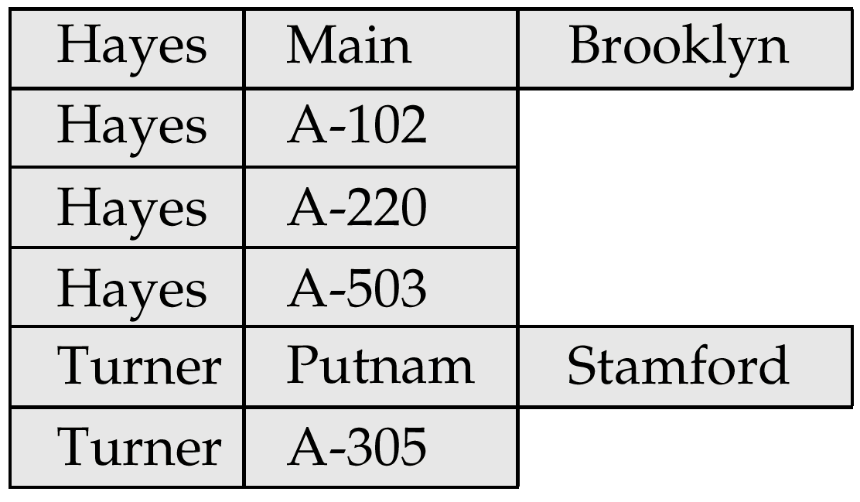
Clustering File Organization
Simple file structure stores each relation in a separate file
Can instead store several relations in one file using a clustering file organization
E.g., clustering organization of customer and depositor:
good for queries involving depositor customer, and for queries involving one single customer and his accounts
bad for queries involving only customer
results in variable size records

Slide 38
Data Dictionary Storage
Data dictionary (also called system catalog) stores metadata: that is, data about data, such as
Information about relations
names of relations
names and types of attributes of each relation
names and definitions of views
integrity constraints
User and accounting information, including passwords
Statistical and descriptive data
number of tuples in each relation
Physical file organization information
How relation is stored (sequential/hash/…)
Physical location of relation
operating system file name or
disk addresses of blocks containing records of the relation
Information about indices.

Slide 39
Data Dictionary Storage (Cont.)
Catalog structure: can use either
specialized data structures designed for efficient access
a set of relations, with existing system features used to ensure efficient access
The latter alternative is usually preferred
A possible catalog representation:
Relation-metadata = (relation-name, number-of-attributes, storage-organization, location) Attribute-metadata = (attribute-name, relation-name, domain-type, position, length)
User-metadata = (user-name, encrypted-password, group)
Index-metadata = (index-name, relation-name, index-type, index-attributes)
View-metadata = (view-name, definition)

Slide 40
Mapping of Objects to Files
Mapping objects to files is similar to mapping tuples to files in a relational system; object data can be stored using file structures.
Objects in O-O databases may lack uniformity and may be very large; such objects have to managed differently from records in a relational system.
Set fields with a small number of elements may be implemented using data structures such as linked lists.
Set fields with a larger number of elements may be implemented as separate relations in the database.
Set fields can also be eliminated at the storage level by normalization.
Similar to conversion of multivalued attributes of E-R diagrams to relations

Slide 41
Mapping of Objects to Files (Cont.)
Objects are identified by an object identifier (OID); the storage system needs a mechanism to locate an object given its OID (this action is called dereferencing).
logical identifiers do not directly specify an object’s physical location; must maintain an index that maps an OID to the object’s actual location.
physical identifiers encode the location of the object so the object can be found directly. Physical OIDs typically have the following parts:
1. a volume or file identifier
2. a page identifier within the volume or file
3. an offset within the page

Slide 42
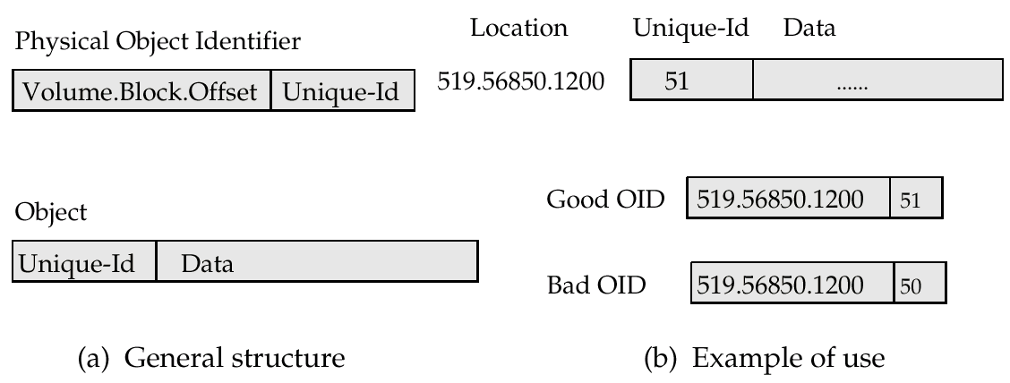
Management of Persistent Pointers
Physical OIDs may be a unique identifier. This identifier is stored in the object also and is used to detect references via dangling pointers.

Slide 43
Management of Persistent Pointers (Cont.)
Implement persistent pointers using OIDs; persistent pointers are substantially longer than are in-memory pointers
Pointer swizzling cuts down on cost of locating persistent objects already in-memory.
Software swizzling (swizzling on pointer deference)
When a persistent pointer is first dereferenced, the pointer is swizzled (replaced by an in-memory pointer) after the object is located in memory.
Subsequent dereferences of of the same pointer become cheap.
The physical location of an object in memory must not change if swizzled pointers pont to it; the solution is to pin pages in memory
When an object is written back to disk, any swizzled pointers it contains need to be unswizzled.

Slide 44
Disk versus Memory Structure of Objects
The format in which objects are stored in memory may be different from the formal in which they are stored on disk in the database. Reasons are:
software swizzling – structure of persistent and in-memory pointers are different
database accessible from different machines, with different data representations
Make the physical representation of objects in the database independent of the machine and the compiler.
Can transparently convert from disk representation to form required on the specific machine, language, and compiler, when the object (or page) is brought into memory.

Slide 45
Summary
Overview of Physical Storage Media
Magnetic Disks
Storage Access
File Organization
Organization of Records in Files
Data-Dictionary Storage

Slide 46
Quiz
The storage structure which do not survive system crashes are ______ a) Volatile storage b) Non-volatile storage c) Stable storage d) Dynamic storage

Slide 47
Quiz
The storage structure which do not survive system crashes are ______ a) Volatile storage b) Non-volatile storage c) Stable storage d) Dynamic storage
Answer a

Slide 48
Quiz
The unit of storage that can store one are more records in a hash file organization are a) Buckets b) Disk pages c) Blocks d) Nodes

Slide 49
Quiz
The unit of storage that can store one are more records in a hash file organization are a) Buckets b) Disk pages c) Blocks d) Nodes
Answer a

Slide 50


Slide 51
The End

